Slide 1

INTRODUCTION TO R
Prepared for Oncology Pod, Pune
Date: 4/4/2018

Slide 2





R Training Sessions
Introduction to R
Data Manipulation in R
Transforming Data in R
Data Visualization in R
Correlation and
Regression
Key Objectives:
Learn how to manipulate data in R
Transforming datasets in R
Learn to create standard (boxplot, histogram etc.) and custom (correlation matrix, density plots etc.) charts in R
Learn initial data diagnostics to model a linear regressor in R and refine it based on preliminary iteration results

Slide 3
INTRODUCTION TO R
Background:
R is a free software implementation of the S language
Pros:
Extendable, with numerous add-on packages available.
R is free and open source software, allowing anyone to use and, importantly, to modify it
The graphical capabilities of R are outstanding, providing a fully programmable graphics language that surpasses most other statistical and graphical packages
R plays well with many other tools, importing data, for example, from CSV les, SAS, and SPSS, or directly from Microsoft Excel, Microsoft Access, Oracle, MySQL, and SQLite
R is the most comprehensive statistical analysis package available. It incorporates all of the standard statistical tests, models, and analyses, as well as providing a comprehensive language for managing and manipulating data

Slide 4
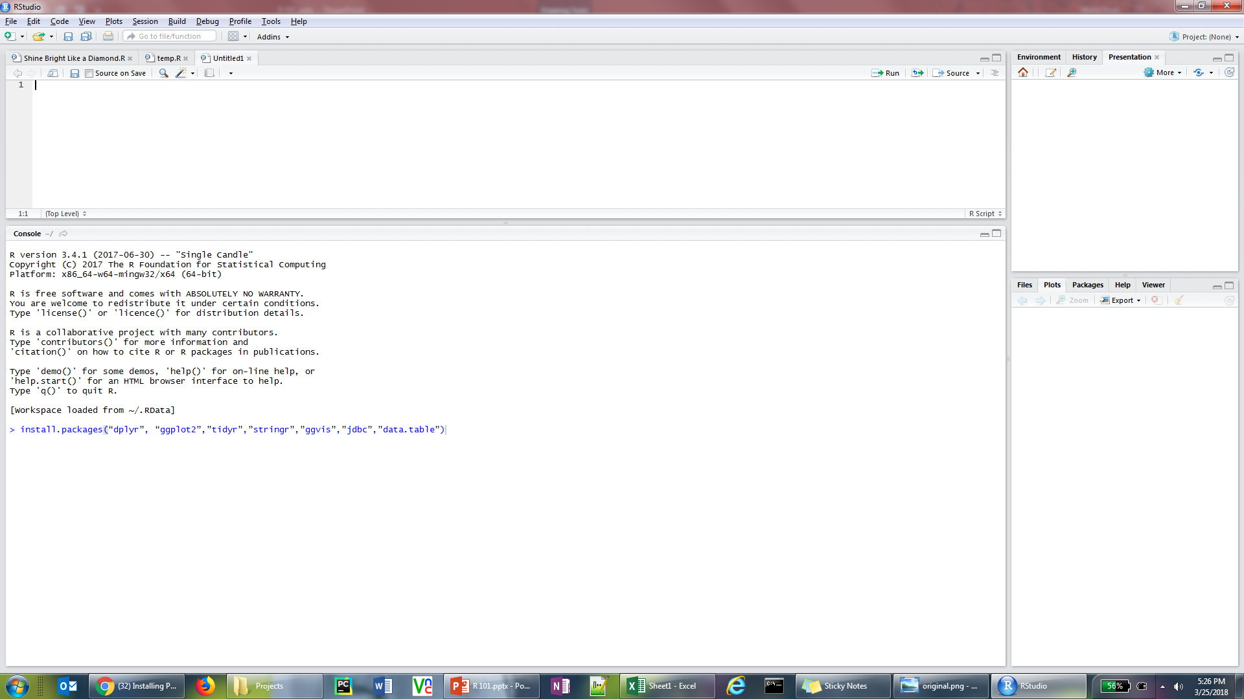
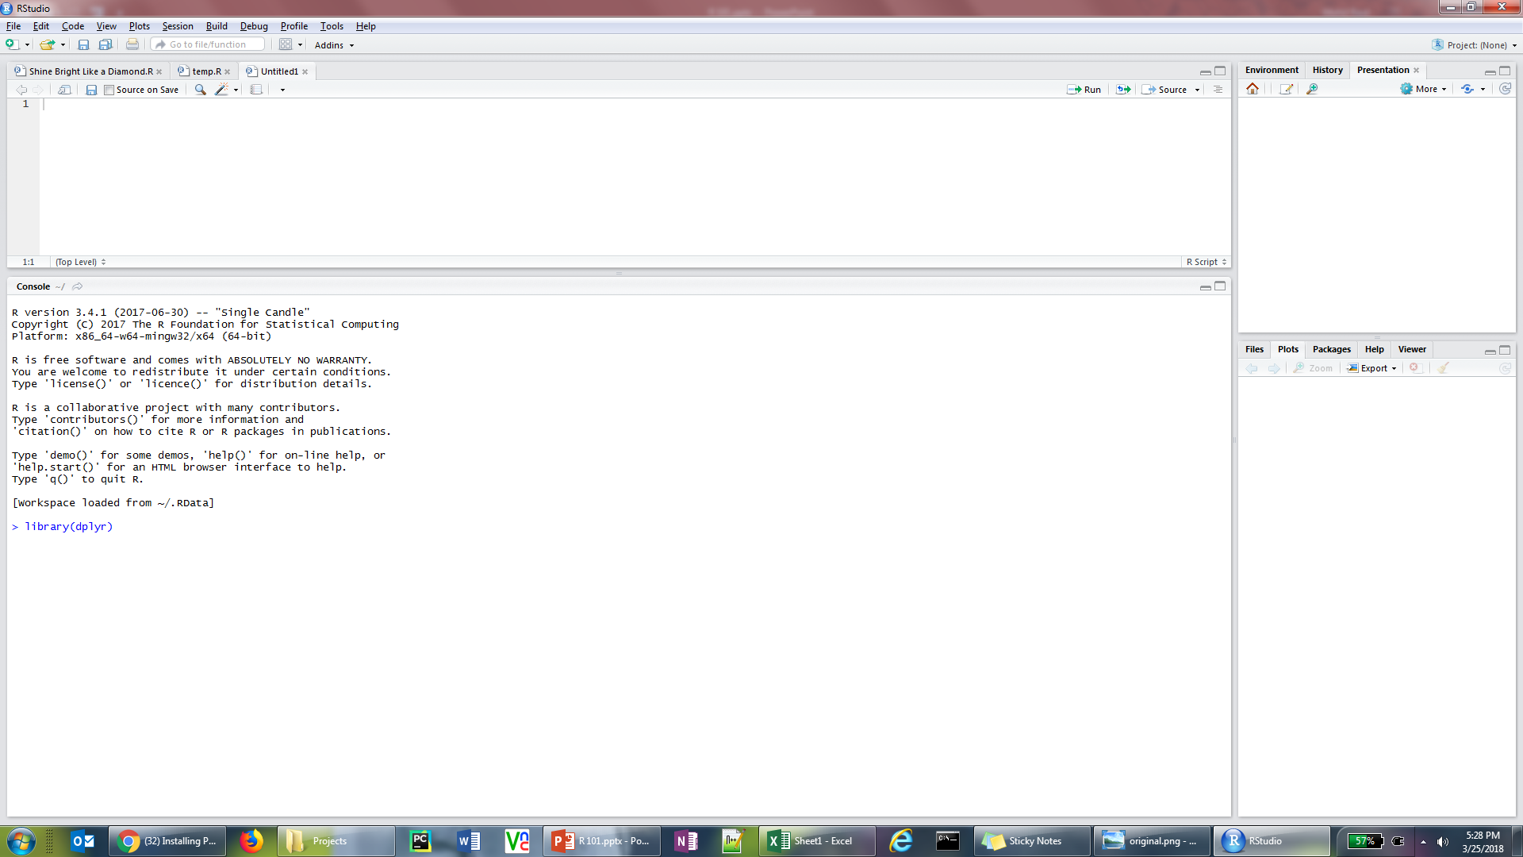
INTRODUCTION TO R
Installing R
Install the latest version of R from the following link: Download R
Download the latest version of Rstudio from the following link: Download Rstudio
After installation, contact IT to get access for all of the following steps required to install packages in R
In the console window type in the following command to install all required packages needed for the training sessions
install.packages(“dplyr”, “ggplot2”,”tidyr”,”stringr”,”ggvis”,”jdbc”,”data.table”)
Load the packages by calling the library command in the Rconsole
library(dplyr) etc.
Visit the following link for any assistance required for package installation: Installing Packages in R

Slide 5
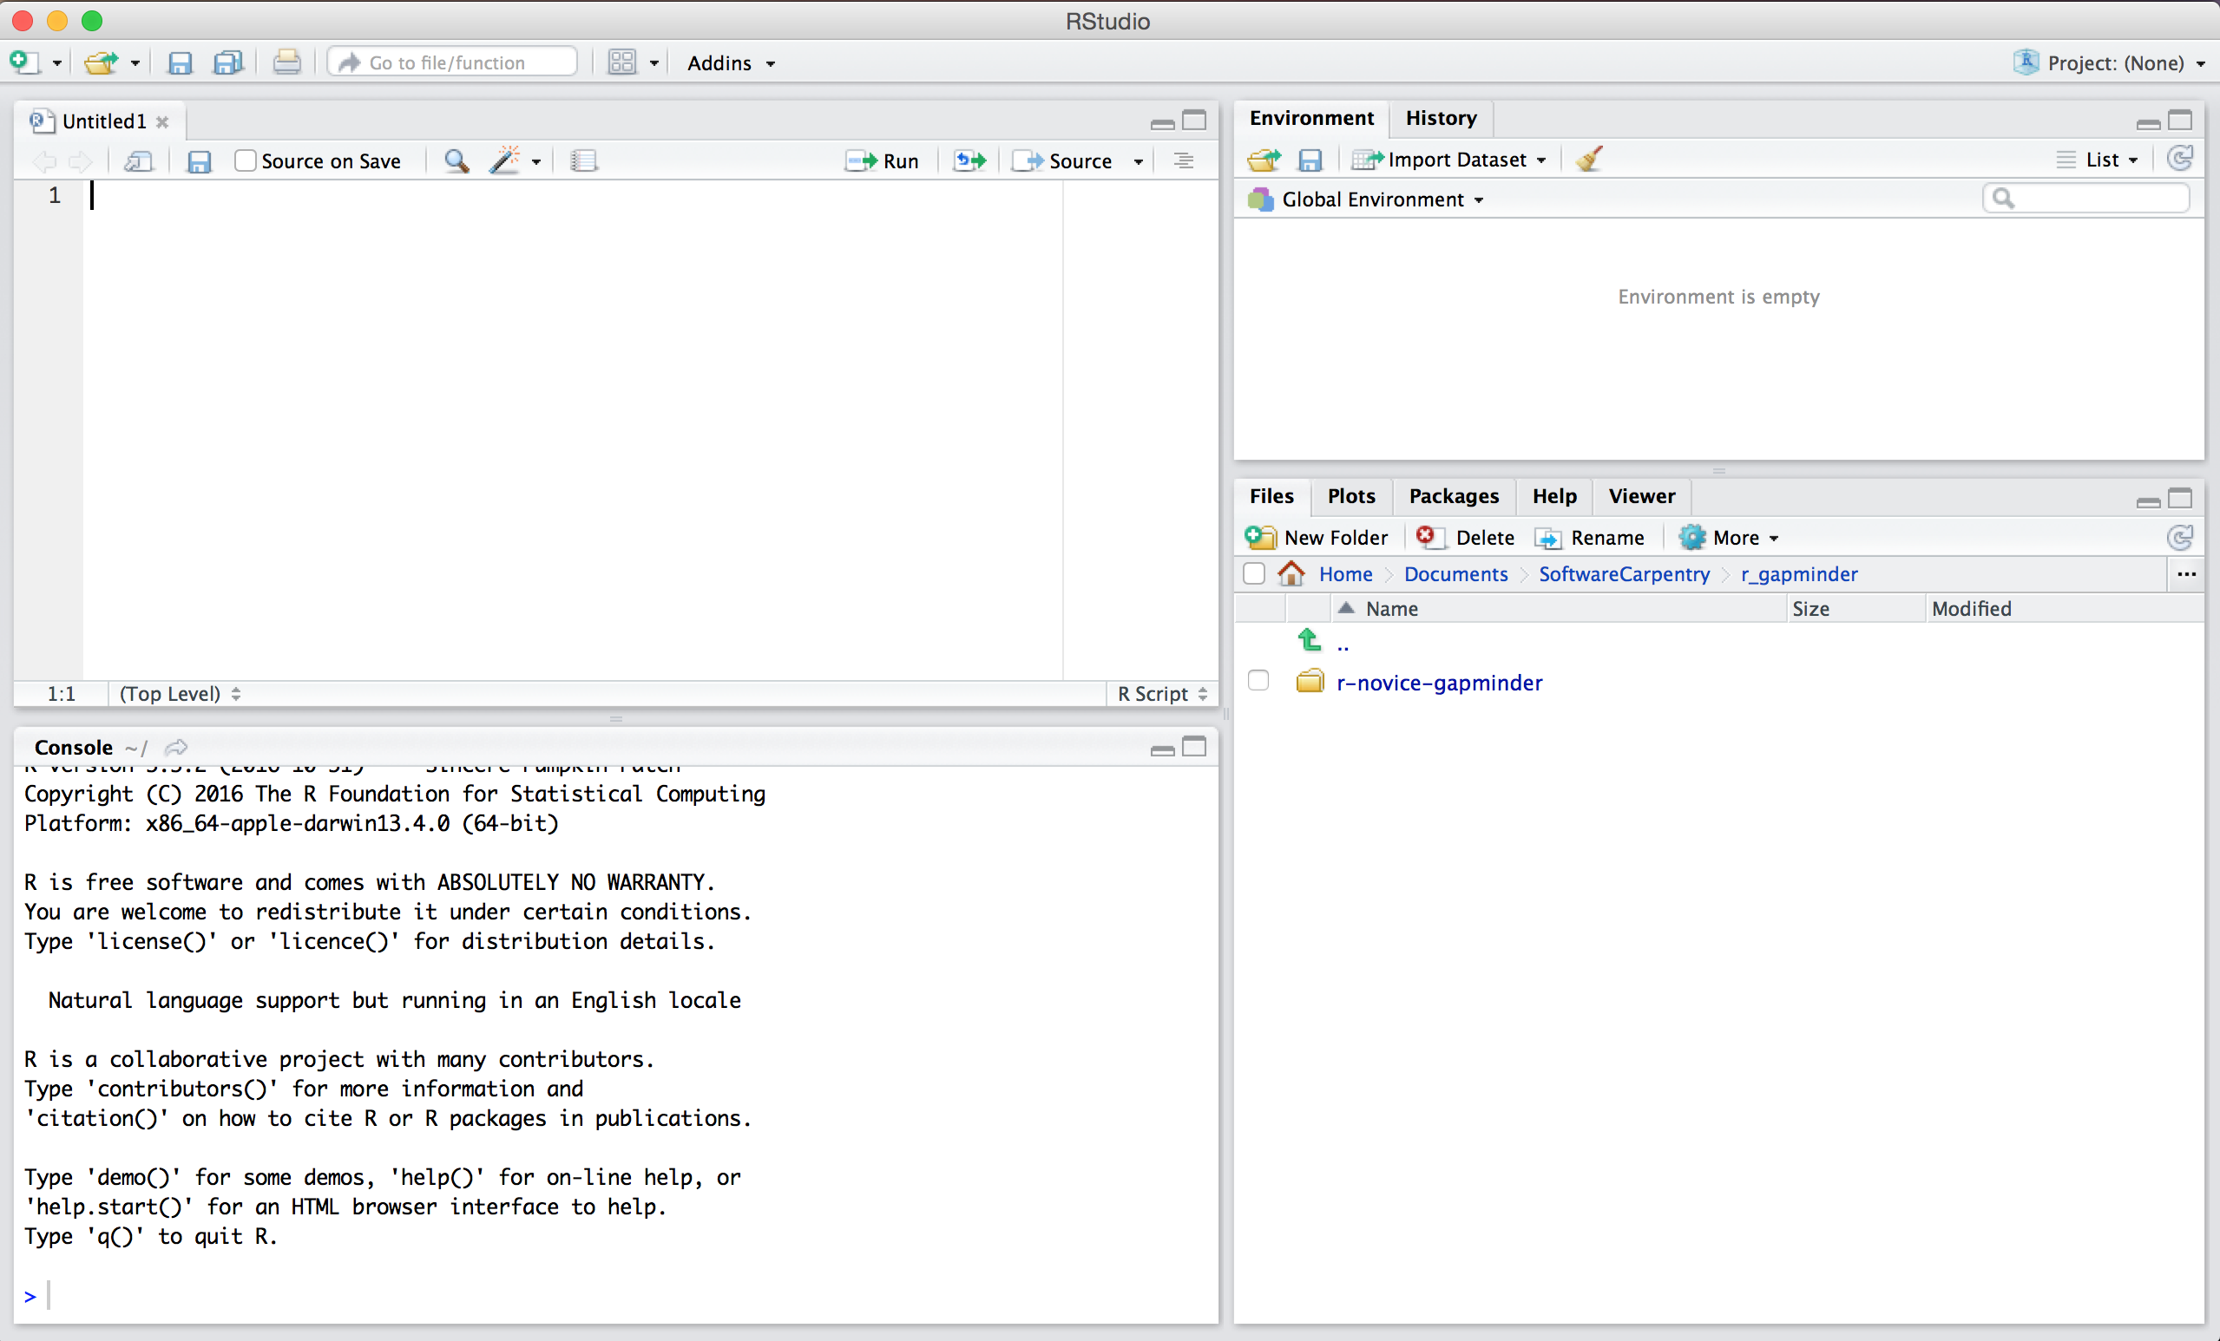
INTRODUCTION TO R
RStudio Layout

Slide 6
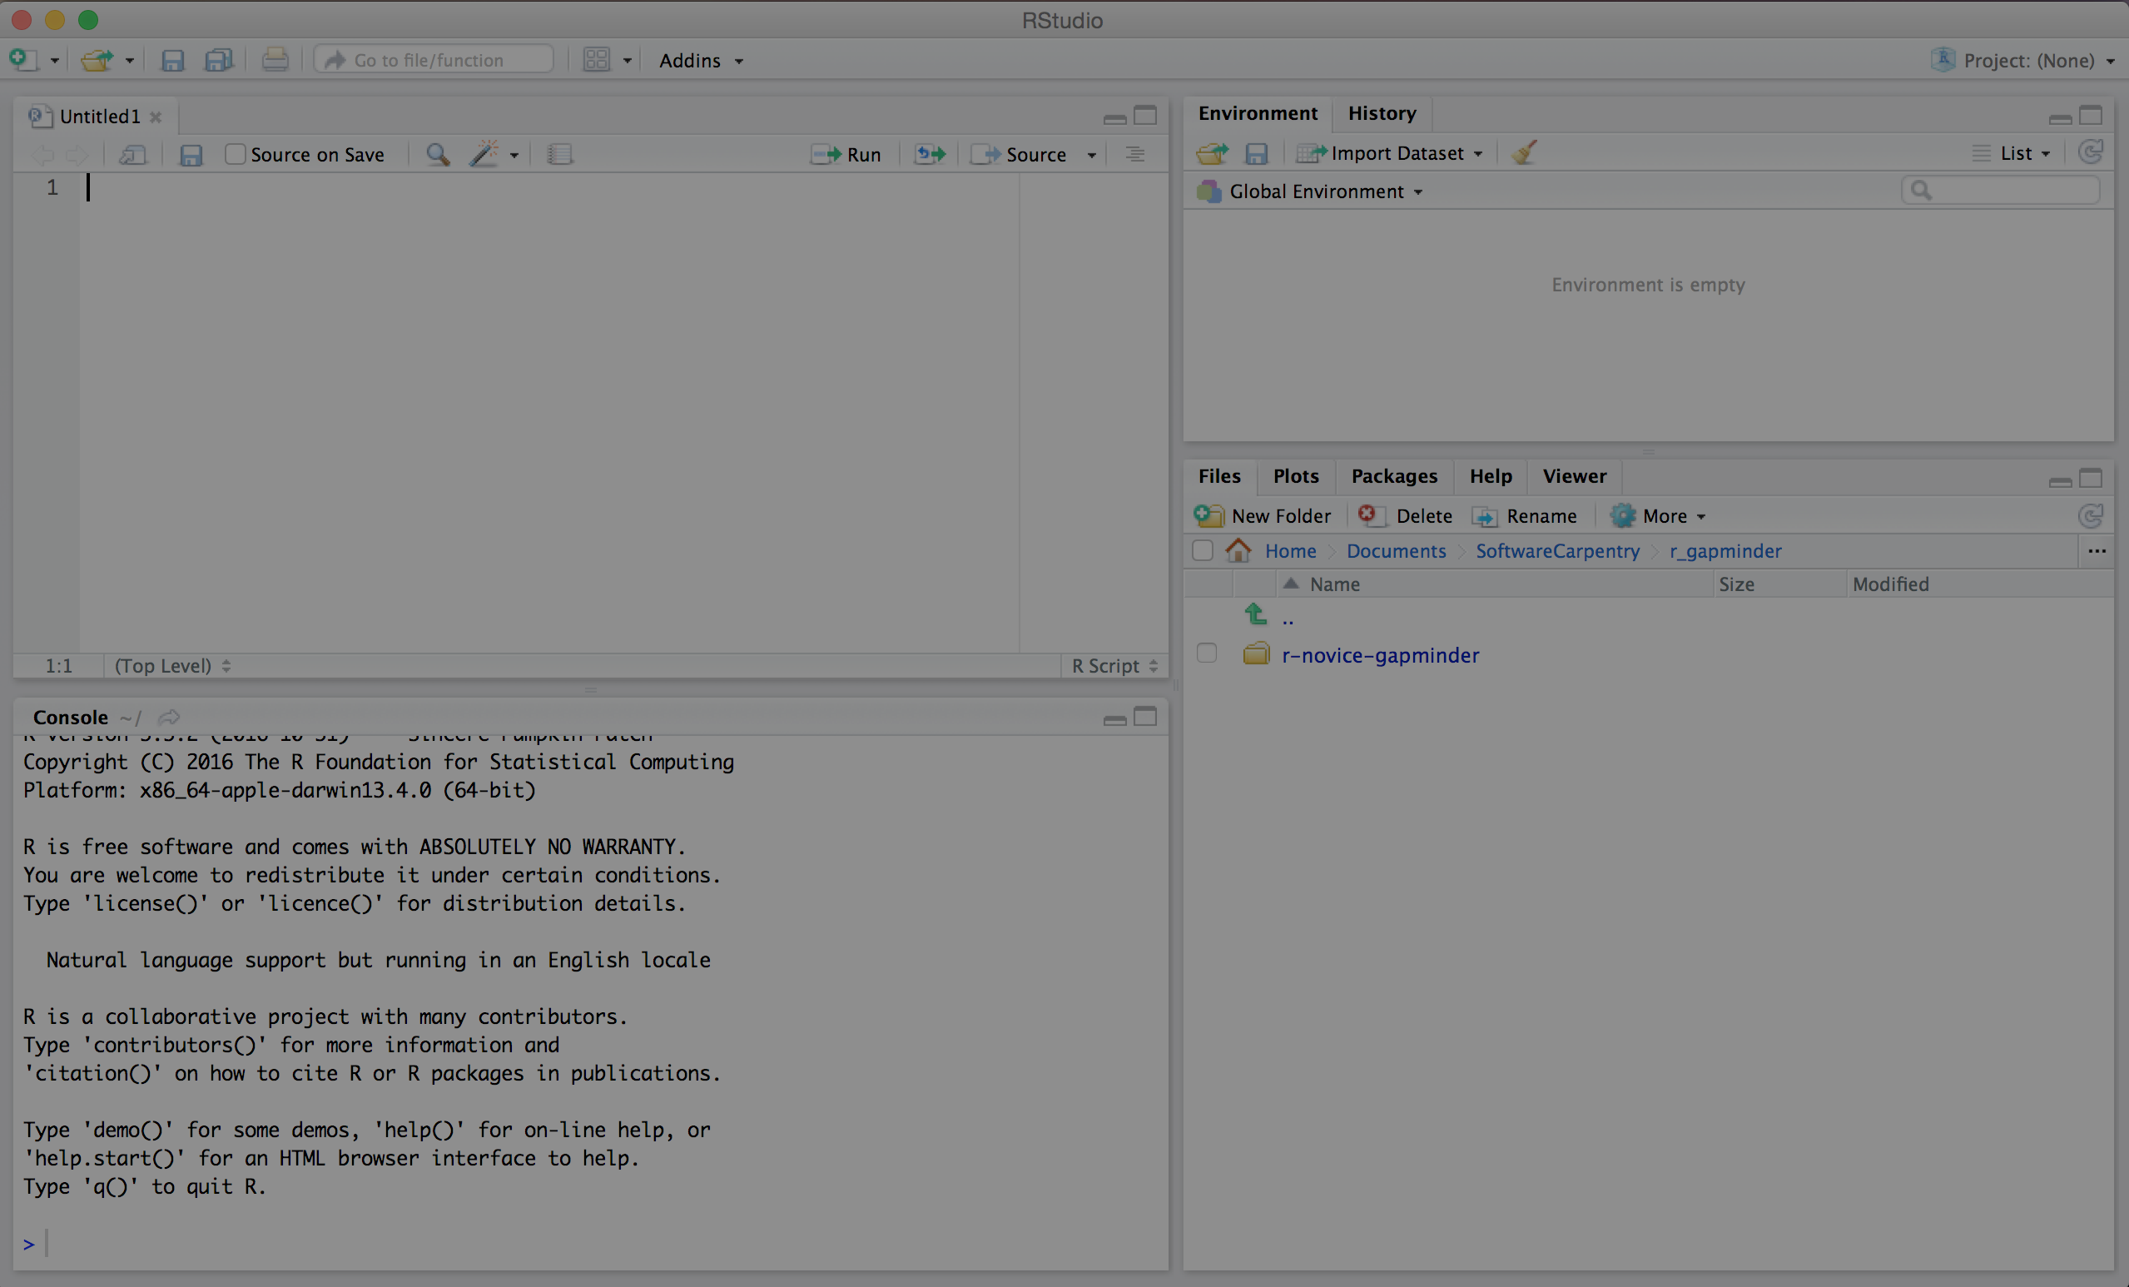
INTRODUCTION TO R
RStudio Layout: Script Window
Text Editor/Script Window
Create New R Script, Notebook, Markdown
Multiple Codes can be opened simultaneously
Use the Run button to compile and execute your script

Slide 7
INTRODUCTION TO R
RStudio Layout
Console Window
Type any valid R command after the > prompt followed by Enter and R will execute that command.
Any error encountered while running an R Script from the text editor will be shown in the console window

Slide 8
INTRODUCTION TO R
RStudio Layout
Viewer Pane
The Packages tab enlist all packages installed on the system and can be used to install/update packages also
The Plots tab displays the latest graph or chart plotted
in an R session
The Help tab is a searchable user guide to look for additional help on functions, packages etc.
The Files tab shows enlists files in your current directory
The Viewer tab helps to preview the layout of R shiny dashboards

Slide 9
INTRODUCTION TO R
RStudio Layout
Environment/History Pane
The environment window contains objects (data, values, functions) R has currently stored in its memory
The history window shows all commands that were executed in the console

Slide 10
INTRODUCTION TO R
Setting up environment in R
The following are the best practice commands to set up R before starting on a new script:
Setting up default directory
library(dplyR)
library(ggplot2)
Load all packages using the library function at the start of the code
setwd(“C:/Projects/STAT/10. R Sessions for Onc Pod”)
The default directory is where you can directly import/export data without specifying the path
The path should be written in with ‘/’ instead of ‘\’.
Basic Commands
Operator | Description
+ | addition
- | subtraction
* | multiplication
/ | division
^ or ** | exponentiation
x %% y | modulus (x mod y) 5%%2 is 1
x %/% y | integer division 5%/%2 is 2
Operator | Description
< | less than
<= | less than or equal to
> | greater than
>= | greater than or equal to
== | exactly equal to
!= | not equal to
!x | Not x
x | y | x OR y
x & y | x AND y
isTRUE(x) | test if X is TRUE

Slide 11
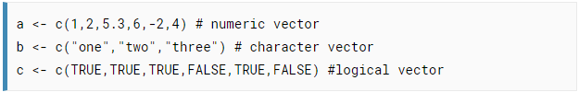
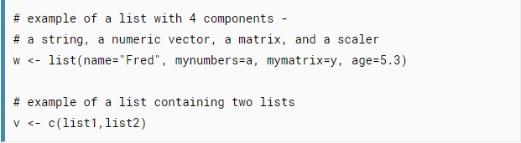

INTRODUCTION TO R
R Data Types
R has a wide variety of data types including scalars, vectors (numerical, character, logical), matrices, data frames, and lists.
Vectors
A vector is a sequence of data elements of the same basic type.
Refer to elements of a vector using subscripts.
Lists
An ordered collection of objects (components). A list allows you to gather a variety of (possibly unrelated) objects under one name.
Identify elements of a list using the [[]] convention.

Slide 12
INTRODUCTION TO R
R Data Types
R has a wide variety of data types including scalars, vectors (numerical, character, logical), matrices, data frames, and lists.
DataFrame: Loading and inspecting data
data=read.csv(“sales.csv”, header=TRUE, sep=“,”)
Load the data by specifying the separator of the raw file
summary(data)
Print summary statistics of the data
str(data)
Check the structure of variable named data
head(data, n)
tail(data, n)
Print top and bottom n rows of the data
colnames(data)
colnames(data)=c(“col1”, “col2”, “col3”)
Print columns of dataframe and change to new column names

Slide 13
INTRODUCTION TO R
R Data Types
R has a wide variety of data types including scalars, vectors (numerical, character, logical), matrices, data frames, and lists.
DataFrame: Filtering data
newdata = data[1:n,]
newdata=data[,1:n]
Select 1st n rows
Select 1st n columns
data[which(conditional expr1 OPERATOR conditional expr2), ]
Select specific observations
The column ends the row indices and empty columns indices selects all columns
mycols=c(“col1”, “col2”, “col3”, “col5”)
data[,mycols]
Filter for selected columns
subset(data, conditional expr1 OPERATOR conditional expr2, select=c(“col1”, “col4”))
Subset data based on conditions
subset(data, conditional expr1 OPERATOR conditional expr2, select=col1:col4)
Select rows conditionally and all columns from col1 to col4

Slide 14
INTRODUCTION TO R
R Data Types
R has a wide variety of data types including scalars, vectors (numerical, character, logical), matrices, data frames, and lists.
DataFrame: Data conversion
is.numeric(data$Col1)
data$Col1=as.numeric(data$Col1)
Check if data type is numeric
Convert object to numeric
is.character(data$Col1)
data$Col1=as.character(data$Col1)
Check if data type is character
Convert object to character
is.list(data$Col1)
data$Col1=as.list(data$Col1)
Check if data type is list
Convert object to list
is.vector(x)
Y=as.vector(x)
Check if data type is vector
Convert object to vector
data.frame(vec1,vec2)
Combine two vectors in a dataframe

Slide 15
INTRODUCTION TO R
Built-in Function
Numeric Functions
Function | Description
abs(x) | absolute value
sqrt(x) | square root
ceiling(x) | ceiling(3.475) is 4
floor(x) | floor(3.475) is 3
trunc(x) | trunc(5.99) is 5
round(x, digits=n) | round(3.475, digits=2) is 3.48
signif(x, digits=n) | signif(3.475, digits=2) is 3.5
cos(x), sin(x), tan(x) | also acos(x), cosh(x), acosh(x), etc.
log(x) | natural logarithm
log10(x) | common logarithm
exp(x) | e^x

Slide 16
INTRODUCTION TO R
Built-in Function
Character Functions
Function | Description
substr(x, start=n1, stop=n2) | Extract or replace substrings in a character vector. x <- "abcdef" substr(x, 2, 4) is "bcd" substr(x, 2, 4) <- "22222" is "a222ef"
grep(pattern, x , ignore.case=FALSE, fixed=FALSE) | Search for pattern in x. If fixed =FALSE then pattern is a regular expression. If fixed=TRUE then pattern is a text string. Returns matching indices. grep("A", c("b","A","c"), fixed=TRUE) returns 2
sub(pattern, replacement, x, ignore.case =FALSE, fixed=FALSE) | Find pattern in x and replace with replacement text. If fixed=FALSE then pattern is a regular expression. If fixed = T then pattern is a text string. sub("\\s",".","Hello There") returns "Hello.There"
strsplit(x, split) | Split the elements of character vector x at split. strsplit("abc", "") returns 3 element vector "a","b","c"
paste(..., sep="") | Concatenate strings after using sep string to separate them. paste("x",1:3,sep="") returns c("x1","x2" "x3") paste("x",1:3,sep="M") returns c("xM1","xM2" "xM3")
toupper(x) | Uppercase
tolower(x) | Lowercase

Slide 17
INTRODUCTION TO R
Built-in Function
Statistical Functions
Function | Description
mean(x, trim=0, na.rm=FALSE) | mean of object x # trimmed mean, removing any missing values and # 5 percent of highest and lowest scores mx <- mean(x,trim=.05,na.rm=TRUE)
sd(x) | standard deviation of object(x). also look at var(x) for variance and mad(x) for median absolute deviation.
median(x) | median
quantile(x, probs) | quantiles where x is the numeric vector whose quantiles are desired and probs is a numeric vector with probabilities in [0,1]. # 30th and 84th percentiles of x y <- quantile(x, c(.3,.84))
range(x) | range
sum(x) | sum
diff(x, lag=1) | lagged differences, with lag indicating which lag to use
min(x) | minimum
max(x) | maximum
scale(x, center=TRUE, scale=TRUE) | column center or standardize a matrix.

